Slide 1
Missense mutation’s snow joke
Kelly Brock
Takeda Group Meeting 2/5/2016

Slide 2
Ongoing projects
Predict effect of missense mutation on protein structure
  Goal: get MD simulations up and running to corroborate experimental values
Modeling CIN through state machine model

Slide 3
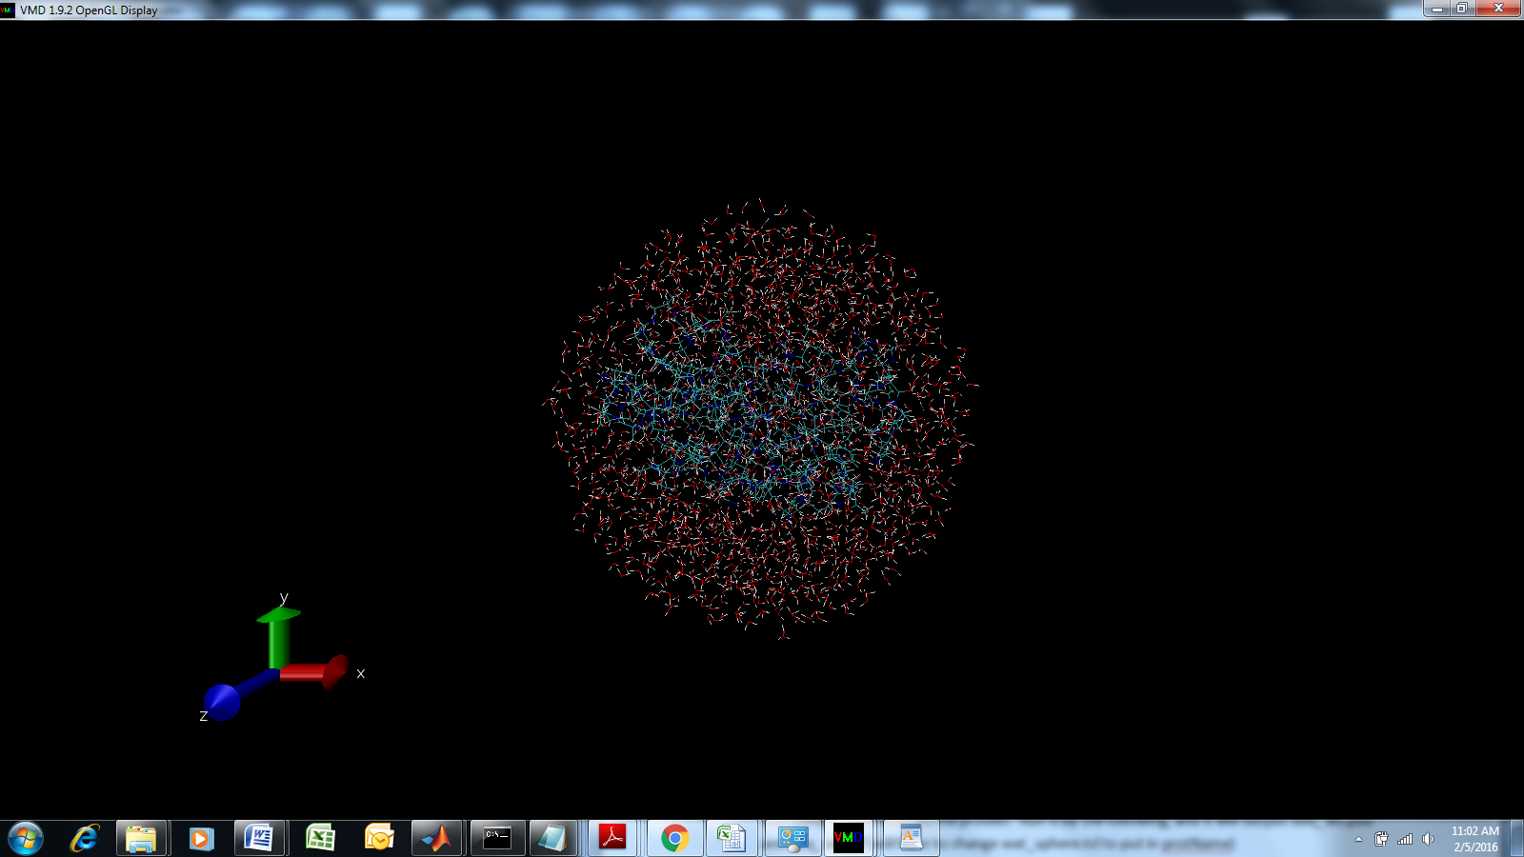
Barnase solvated for MD simulations

Slide 4
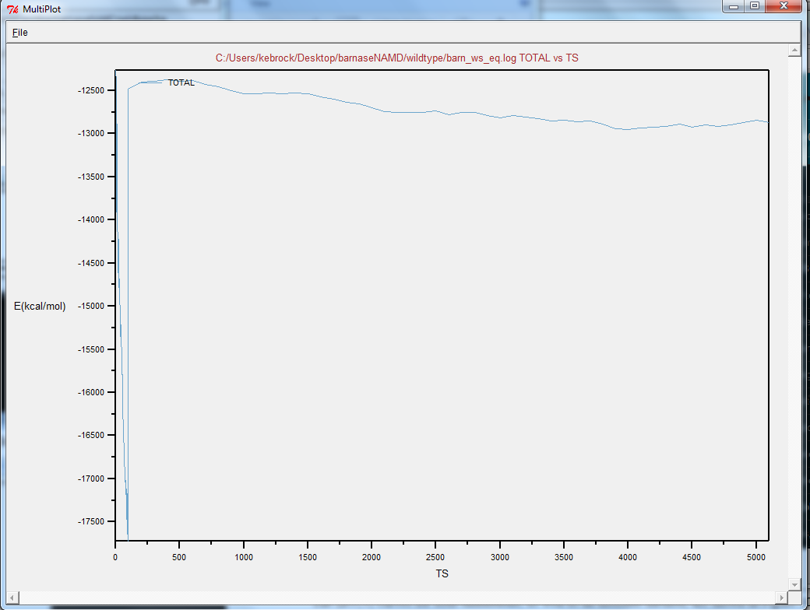
Example of minimizing energy for wildtype protein on truncated run

Slide 5
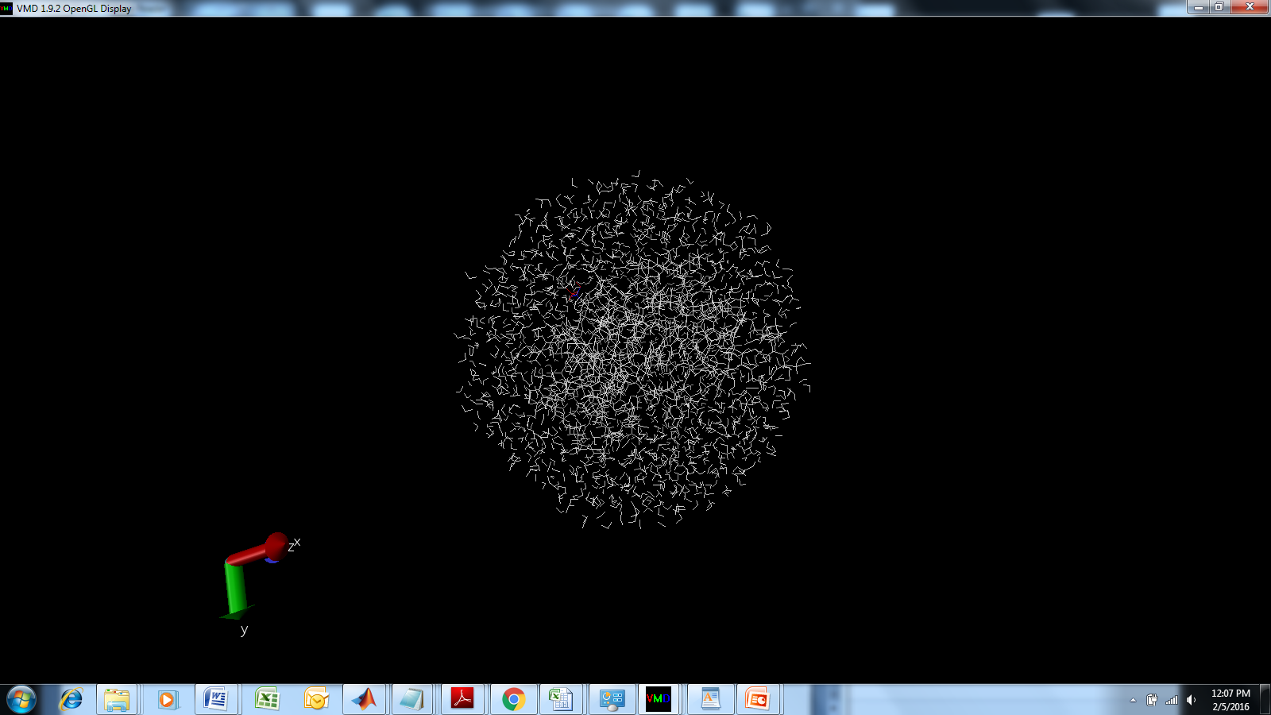
Example of mutating barnase residue 6 from T to A

Slide 6
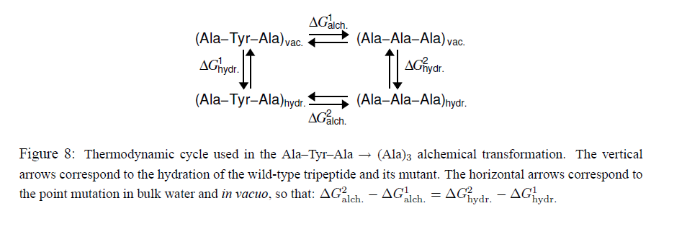
To compute ddG, have to run simulations in multiple states
Tutorial on Alchemical FEP, NAMD homepage

Slide 7
Status and notes
Scalability
  Requires 2 equilibrations and 4 MD runs per computed ddG value
  Equilibration = 0.5 hours, MD run hours on easiest settings

Slide 8
CIN check-in
Review conditions used
Values of m: plot different levels from literature, parameter sweep at top region

Slide 9
Reminder of model values: boundaries at 1, 6N or 40, 120
m1
m2
m3
. . .
2N-1
2N
2N+1
2N+2
4N
ki

Slide 10
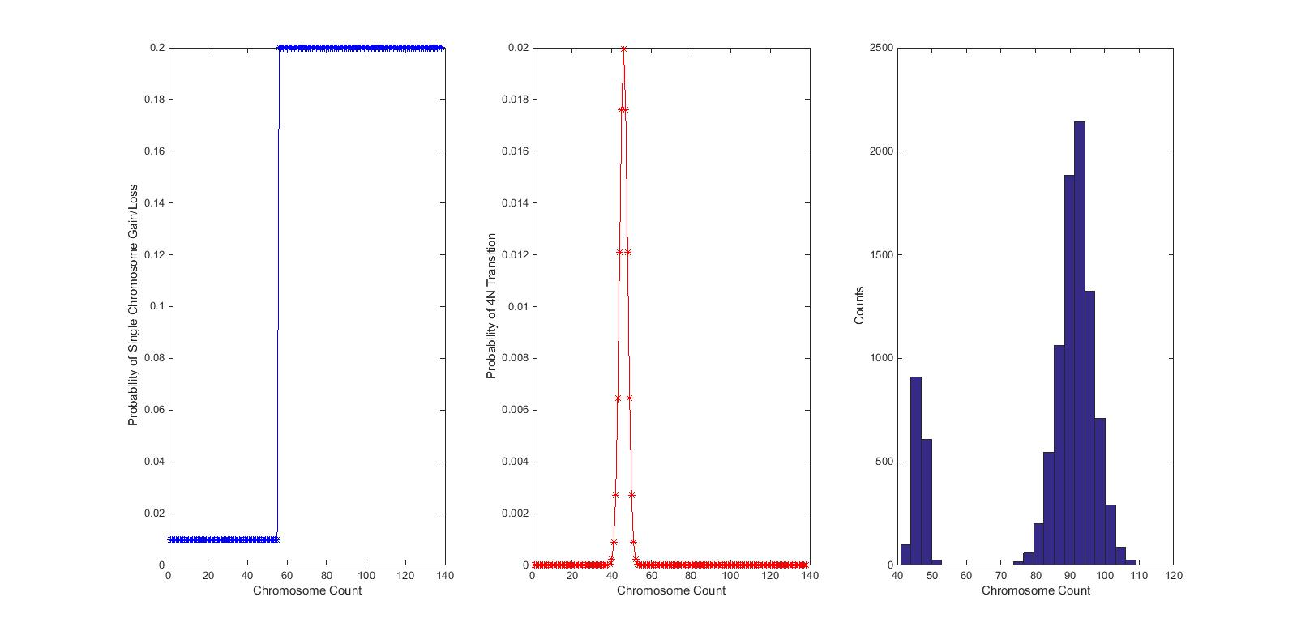
CIN levels match with known experimental missegregation rates, but can add noise

